Slide 1
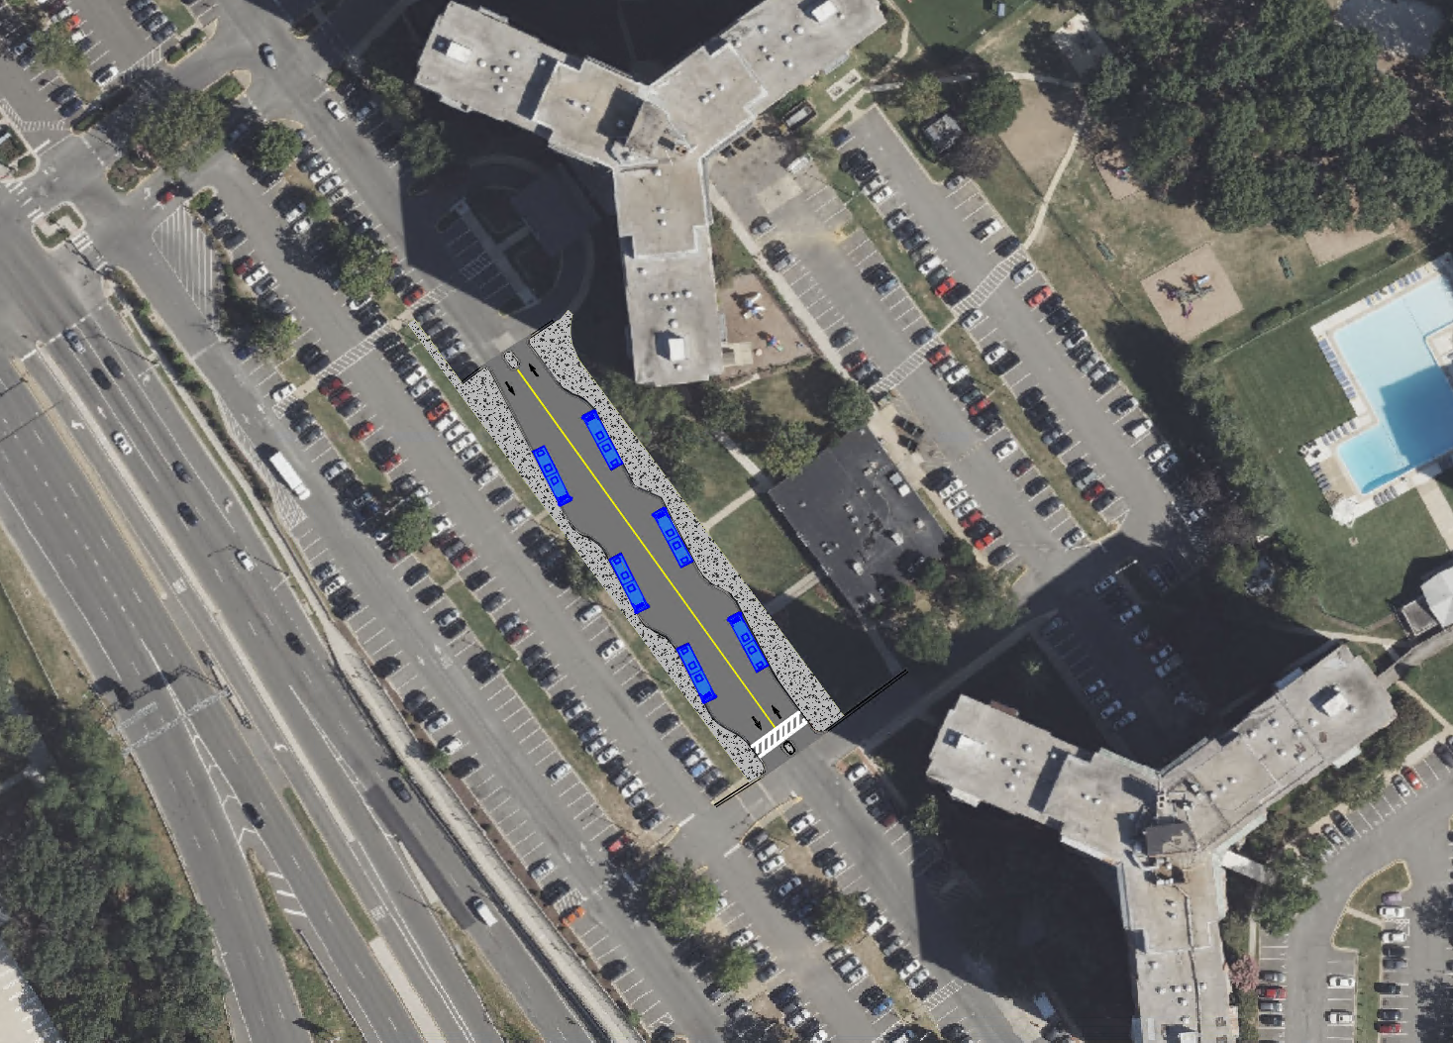
Alternative - 1
SHERWOOD
SEMINARY RD
Bus Stalls: 6 (with sawtooth layout)
Bus Stalls: 8-10 (parallel)
Bus Zone would be closed to public traffic.
Minimal removal of parking spots.
Buses required to traverse through lots.
Likely need improvements or signal on Beauregard.
STRATFORD

Slide 2
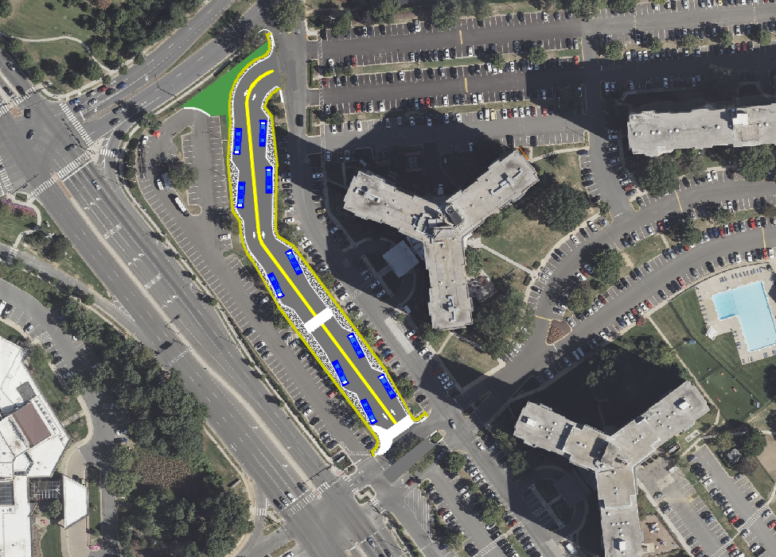
Alternative - 2
N BEAUREGARD ST
MONTICELLO
GRAHAM
SEMINARY RD
Bus Stalls: 10+ (with sawtooth layout)
Bus Stalls: 14+ (parallel)
Bus Zone would be closed to public traffic.
Very limited bus vs. auto interaction.
Isolates parking stalls in front of Graham building.
Greater Distance from other buildings.
Buses required to traverse through lots.
Likely need improvements or signal on Beauregard.
STRATFORD

Slide 3
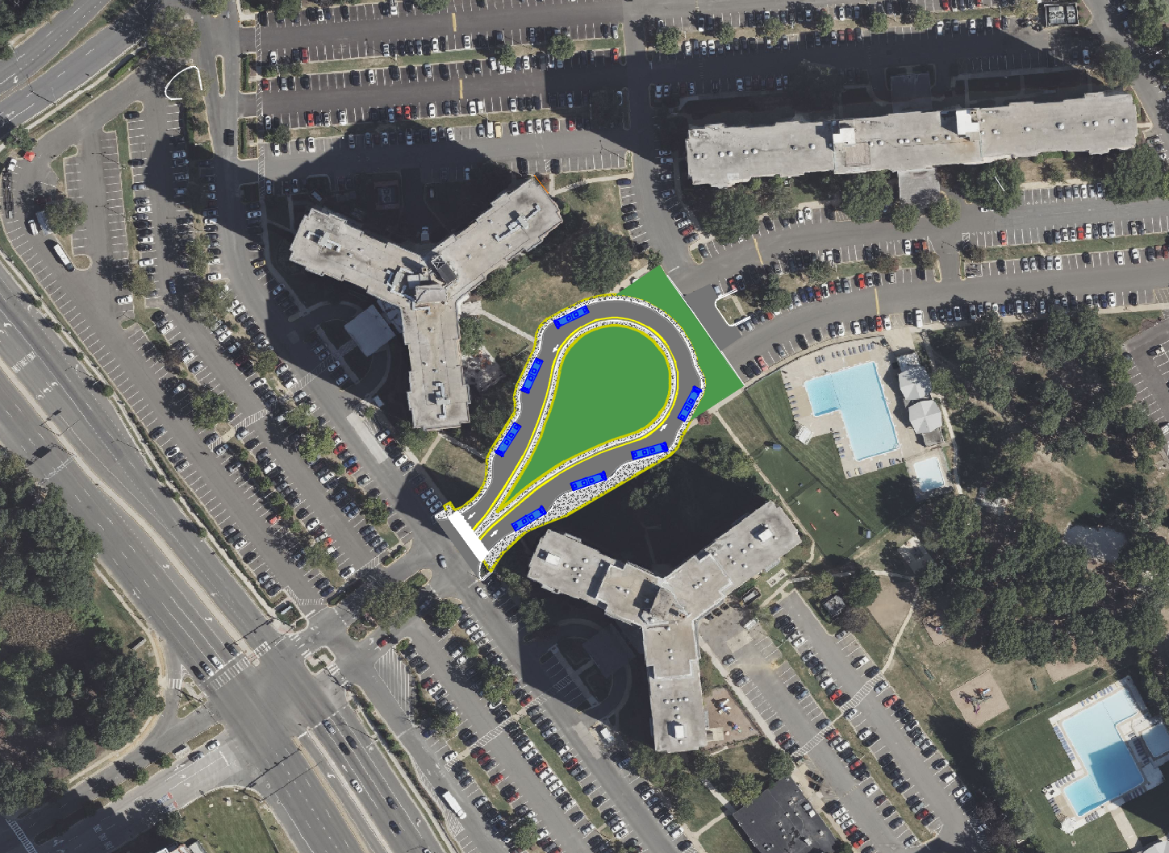
Alternative - 3
MONTICELLO
GRAHAM
Bus Stalls: 7+ (with sawtooth layout)
Bus Stalls: 10+ (parallel)
Bus Zone would be closed to public traffic.
Very limited bus vs. auto interaction.
Very minimal bus vs. pedestrian interaction.
No need for intersection improvements to Beauregard.
Inner portion of bus zone could be one larger bus shelter.
More of a transit center feel.
All buses pass through Seminary Intersection.
Isolates some parking stalls.
STRATFORD
SEMINARY RD

Slide 4
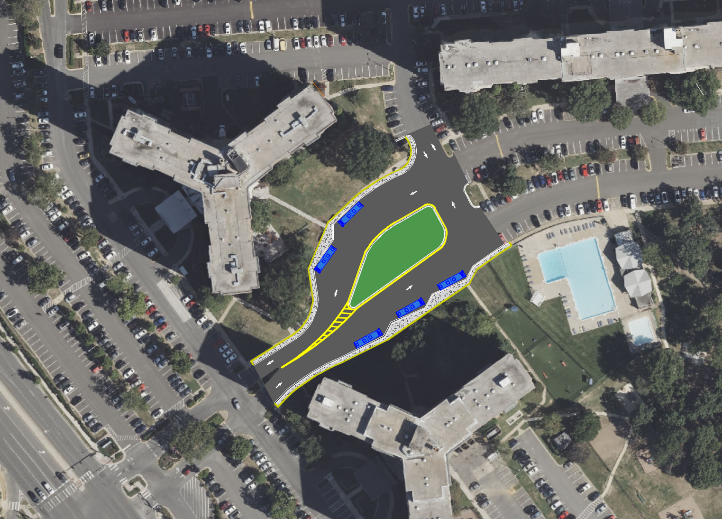
Alternative - 4
MONTICELLO
GRAHAM
Bus Stalls: 6+ (with sawtooth layout)
Bus Stalls: 10+ (parallel)
Minimal disruption to auto traffic
Inner portion of bus zone could be one larger bus shelter.
More of a transit center feel.
Consolidates busses to one location.
Requires busses to traverse through parking lot.
Bus zone not closed to public traffic.
May still require improvements to Beauregard.
STRATFORD

Slide 5
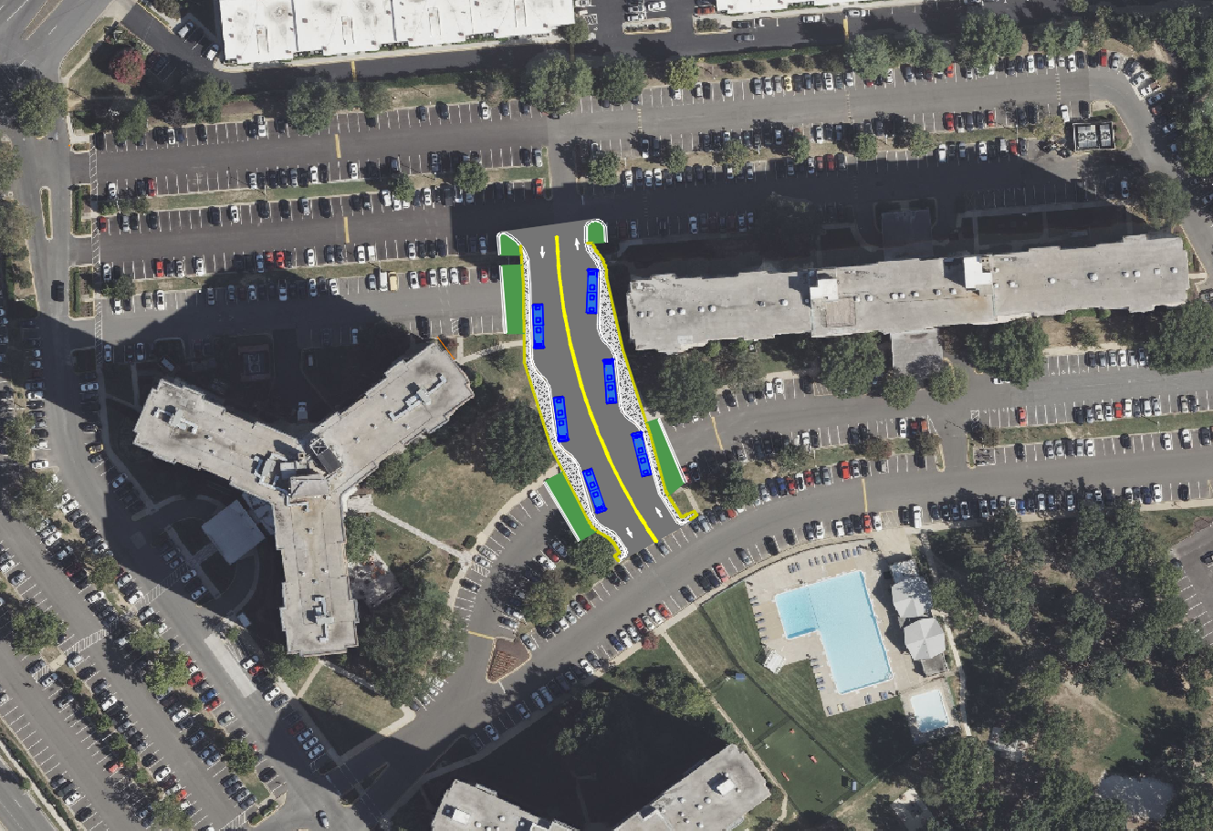
Alternative - 5
GRAHAM
Bus Stalls: 6 (with sawtooth layout)
Bus Stalls: 8 (parallel)
Consolidates busses to one location.
Requires busses to traverse through parking lot.
Some disruption to auto movements.
Isolates some parking stalls.
May still require improvements to Beauregard.

Slide 6
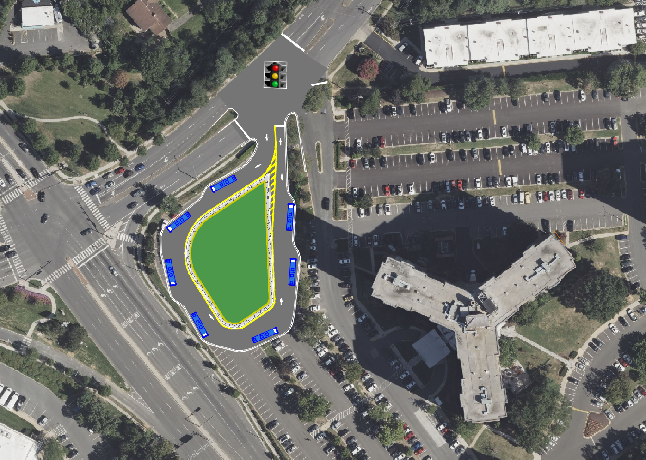
Alternative - 6
N BEAUREGARD ST
Bus Stalls: 7+ (with sawtooth layout)
Bus Stalls: 12+ (parallel)
Minimal disruption to auto traffic
Inner portion of bus zone could be one larger bus shelter.
More of a transit center feel.
Consolidates busses to one location.
Safest option for auto and pedestrians.
Not centrally located.
All buses pass through Seminary Intersection.
Isolates some parking stalls.
Will require improvements/signal to Beauregard.
Green Space
GRAHAM
SEMINARY RD
Commuter Lot
Commuter Lot

